Slide 1
How I grew my Roth IRA from $7,214 to $63,250 in 9 months and keep it growing.
Darrin Carey
Dayton Capital Partners, LLC
(937) 458-3303
Darrin@DaytonCapitalPartners.com

Slide 2
DISCLAIMER
Information presented is not to be construed as legal advice. Opinions and viewpoints are those of the author(s) or the speaker(s).
Author does not give legal, tax, financial, or other investment advice, and disclaims any/all liability for the actions taken or not taken as a result of these communications.
Participants should consult with their own attorney, accountant, certified financial planner, and/or realtor for professional legal, tax, investment, and/or financial planning services when considering real estate or other investments. Real estate, like any other investment, involves a degree of financial risk.

Slide 3
Getting Started
Opened at OREIA 2012 -- $1300 contribution
2014 -- Saw the maintenance fees I’d paid
Jan 2014 -- Transferred cash from a Roth accounts to the SDIRA ($4,916.61)
May 2014 -- Rolled over a traditional IRA to the SDIRA ($1,261.50)

Slide 4
Getting Started
May 29, 2014 Account balance $7,214.93
Let’s do this.

Slide 5
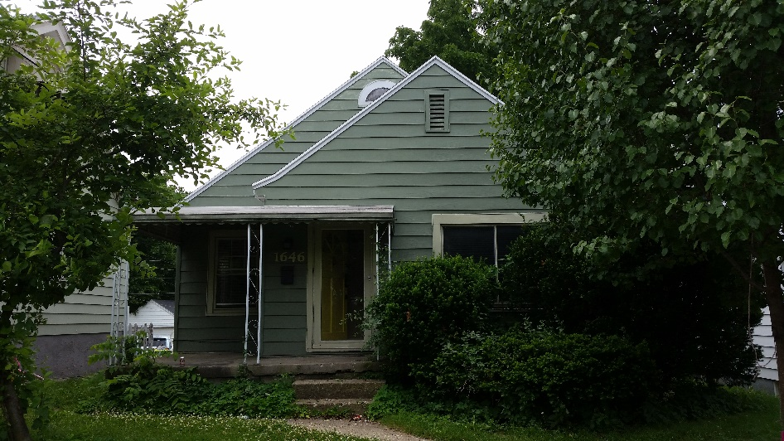
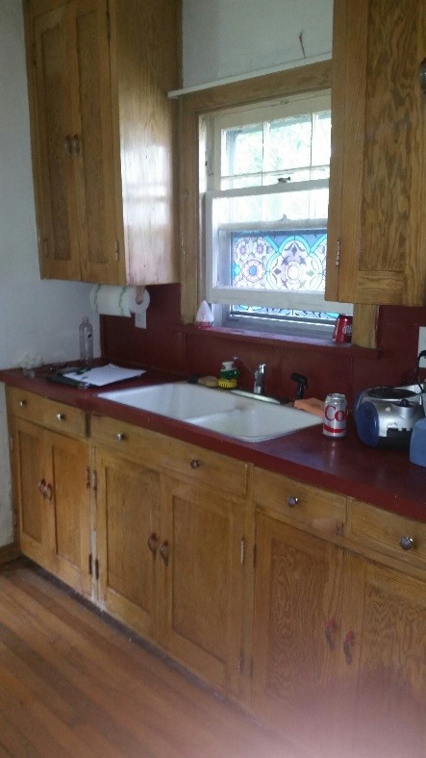
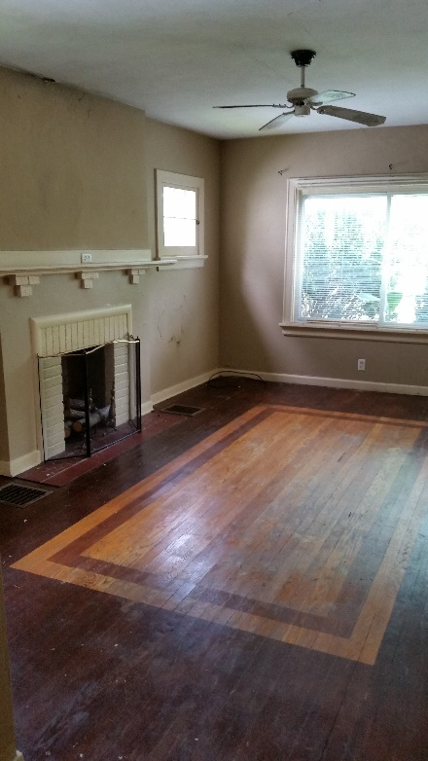
First Run at It (June)
$5,000 to buy ½ with JV
Source: JV partner’s sign
Double close planned
$15,000 sale to Landlord
$2,500 profit to IRA
Seller went silent
Refused to answer calls
Sent funds back to IRA
Notes:
Later, I found out friends signed a contract with him a few days after me. For more of course.
Yes, they were someone I was going to offer it to but hadn’t yet.
No, they didn’t know about my contract.

Slide 6
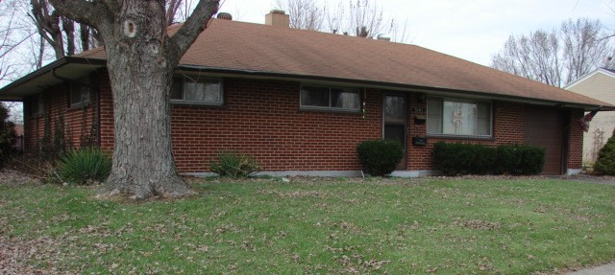
Deal One (July)
$500 – paid ½ of earnest deposit for bank REO
Source: REIA meeting
JV with rehabber, not a loan
$1,732.76 to IRA when it sold 4 months later

Slide 7
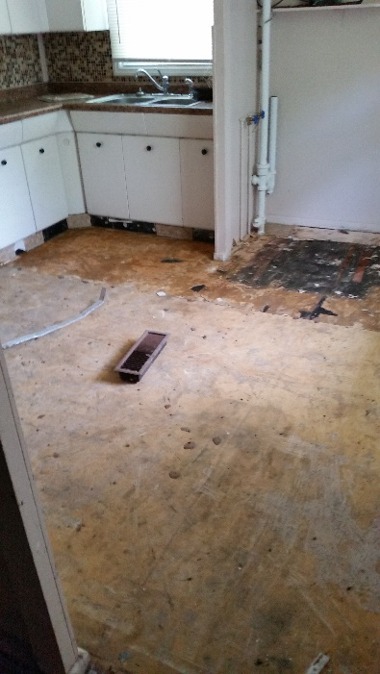
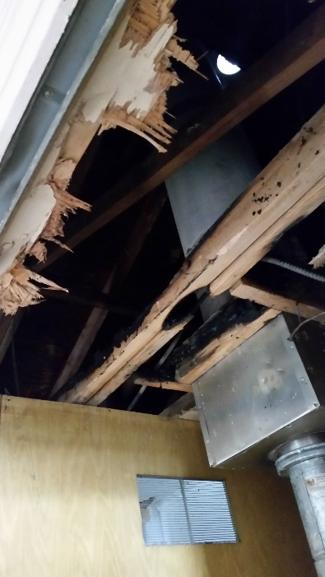
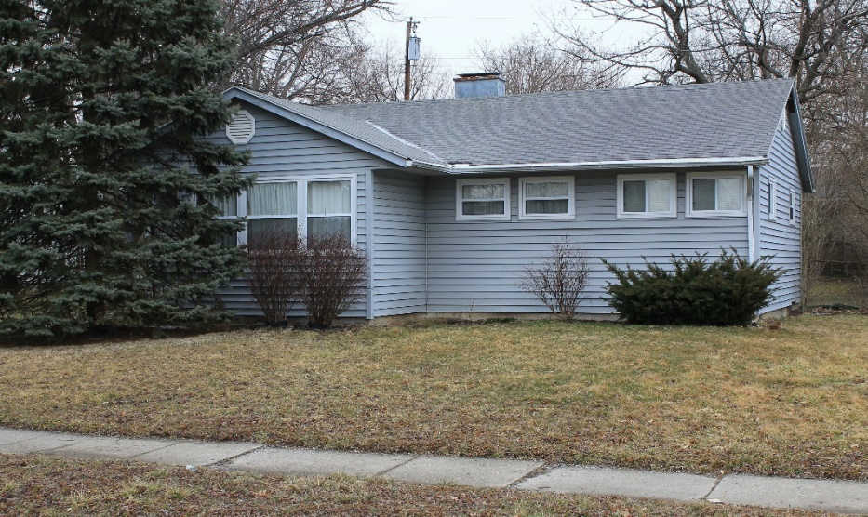
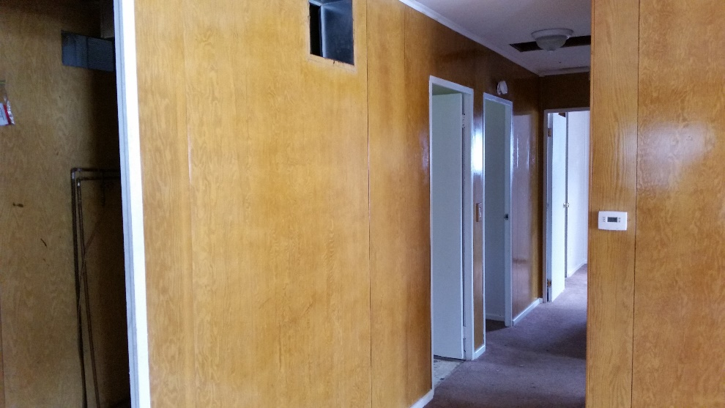
Deal Two (August)
$6,655.93 for 70%
Source: Bird Dog
JV with Self
$11,185.89 to IRA in 4 days
Notes:
11,000 purchase
17,900 sale
4,000 rehab budget
Buyer sold it two years later for 31,900

Slide 8
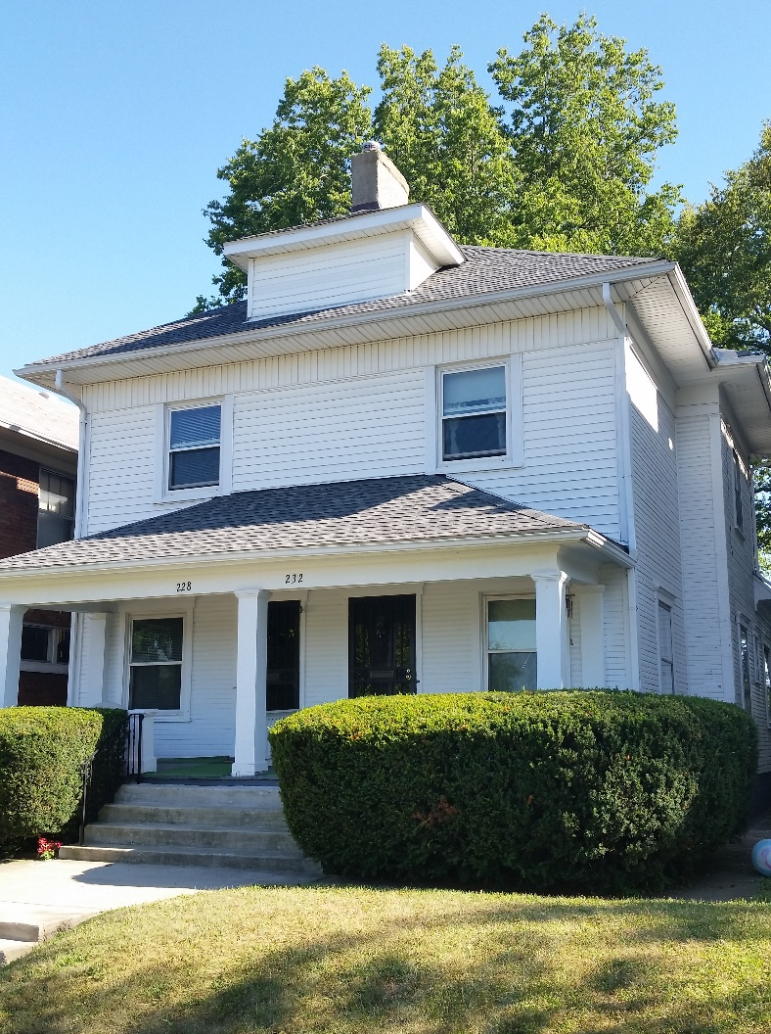
Deal Three (August)
$8,772.50
Source: Bird Dog
Sold with two payments
$11,500 in 3 months
$12,900 in 6 months
$24,352 to IRA in 3 months
Notes:
Buyer still owns it. Rents total $950.

Slide 9
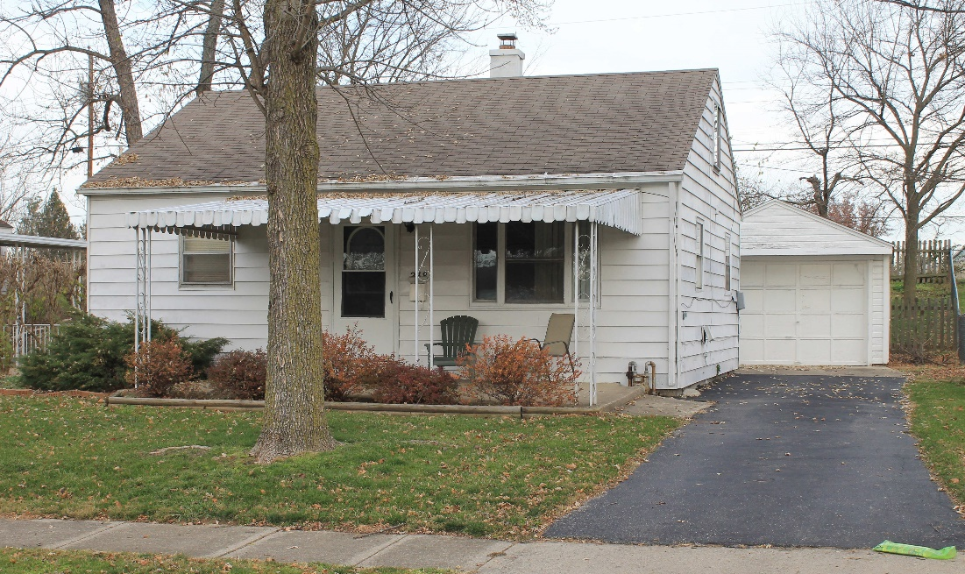
Deal Four (Oct)
$13,092.67
Source: A new Wholesaler
Owned for one week
$19,824.08 to IRA
Notes:
I couldn’t close this deal until I received the first payment on the previous deal. Money was wired in the morning, and out the afternoon.
a new wholesaler called me with the deal. They had it under contract to high, but I told them what I was willing to pay. They ended up going back to the seller and getting a lower price, then called me back. I bought it, then decided I didn’t want a rental in my IRA until I had built up more capital. I sold it to another landlord 3 weeks later.
Needed about 10k in work. Buyer sold it a year later for 50k.

Slide 10
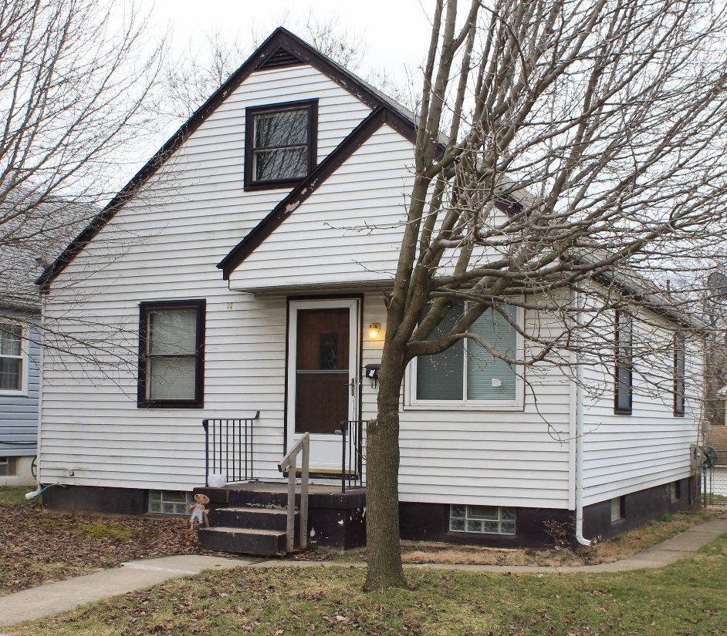
Deal Five (Jan)
$22,102.60
Source: Sign on Truck
Sold on land contract for $49,900
“The Mouth”
Notes:
Seller called me, he was moving to Florida to partner with a buddy on a jet ski business. He needed cash fast for the business.
I’m sure it’s unrelated, but the Federal Marshals showed up a couple weeks after the sale looking for him.

Slide 11
Deal Five (Jan)
$2500 down
8% interest
$404.75 for 20 years
Still paying (2.5 years)
$12,000 so far
$100,000 if 20 years
Notes:
I’ve collected over 12,000 in Principal and Interest so far. If the contract goes the full 20 years, that’ll be almost $100,000 back on the investment.

Slide 12
Nine Months & Five Deals Later
May 29, 2014
$7,214.93
Feb 26, 2015
$63,250.55
Cash $14,860.37
Land Contract $48,390.18

Slide 13
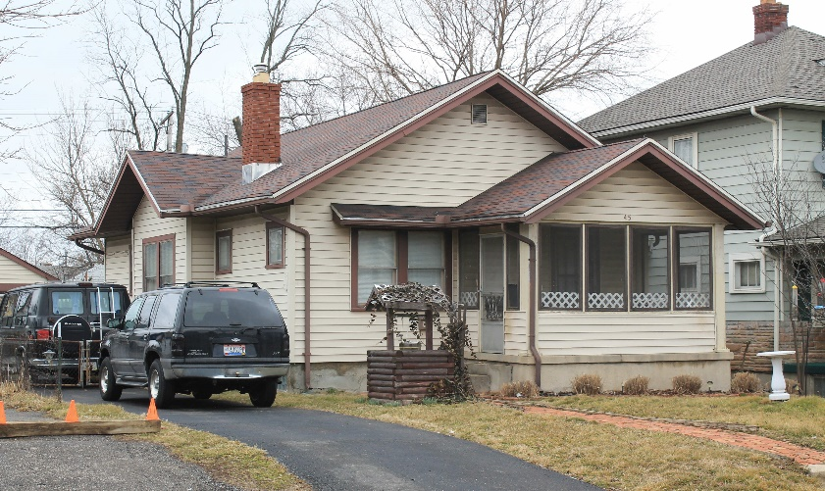
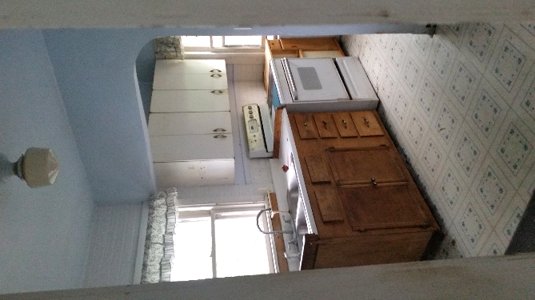
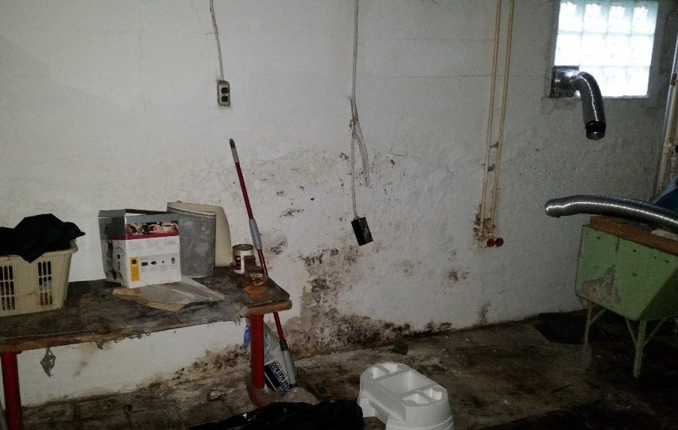
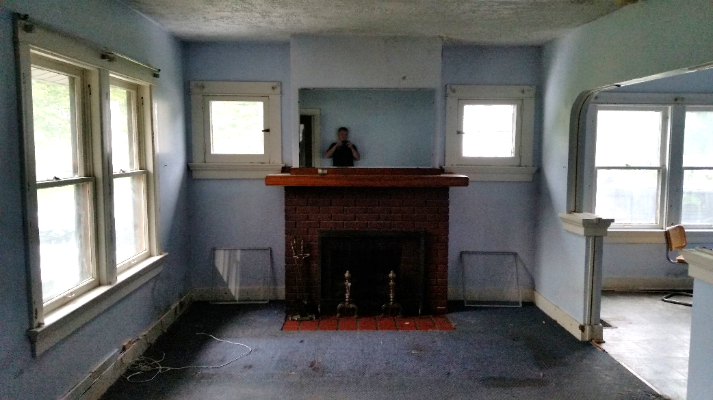
Bonus Deal
$5,000
Source: Website
I was third offer
Notes:
Mom – Payments - Sink
Paid Attorney
Rented for $650

Slide 14
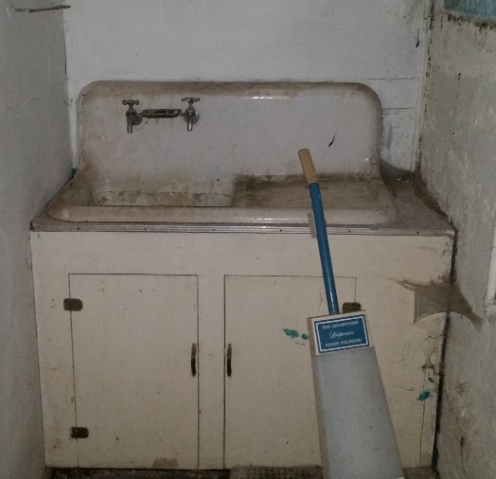
Bonus Deal
Offered for sale
$12,000 cash
$15,000 payments
Received Offers
Several zero down Land Contracts from “Tenants”
$10,000 cash from a Landlord/TK provider
$15,000 with $4,000 down from a Landlord

Slide 15
Bonus Deal
$4,000 down
Note for $11,000
8% interest
$171.45 for 7 years
Still paying (2.5 years)
$5,500 so far
$18,401 for 7 years
Notes:
I’ve collected over 12,000 in Principal and Interest so far. If the contract goes the full 20 years, that’ll be almost $100,000 back on the investment.

Slide 16
Keep it Growing
3 Wholesales - sold cash
One with Spouse IRA
2 Wholesales – sold on performing notes
3 HML Loans
One with partner
One with Spouse IRA
8 Transactional Loans

Slide 17
Current Inflows
$350 per month for 6 years
$400 per month for 17 years
That’s $750 every month going into my IRA without any more contributions!

Slide 18
Dayton Capital Partners
That was my IRA. What about yours?
Use us to get your IRA funds working
Process
Paperwork
Deals
Stop at our table and see us
Darrin Carey
(937) 458-3303
Darrin@DaytonCapitalPartners.com

